Slide 1
It Came From Space
Decoding Weather Satellites for Cheap
hamster – KD5WGW
ZIACON6

Slide 2

INTRO
I’m hamster
KD5WGW
Master Chicken Wrangler

Slide 3
Weather Satellite Decoding
It’s easy
It’s free and not encrypted
It’s legal
It’s cheap to setup a station

Slide 4
SATELLITE HISTORY

Slide 5
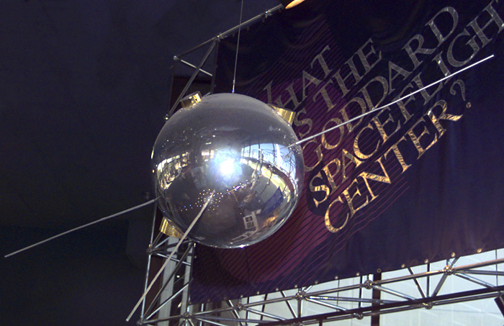
Weather Satellite History
Vanguard 2
Launched February 1959 by the US Navy’s Project Vanguard
In operation for 19 days
Two photocells looking at reflected sunlight from clouds
Recorded data to tape, rewound, and transmitted back to ground
Last contact March 1959 – but will be in orbit until 2259!

Slide 6
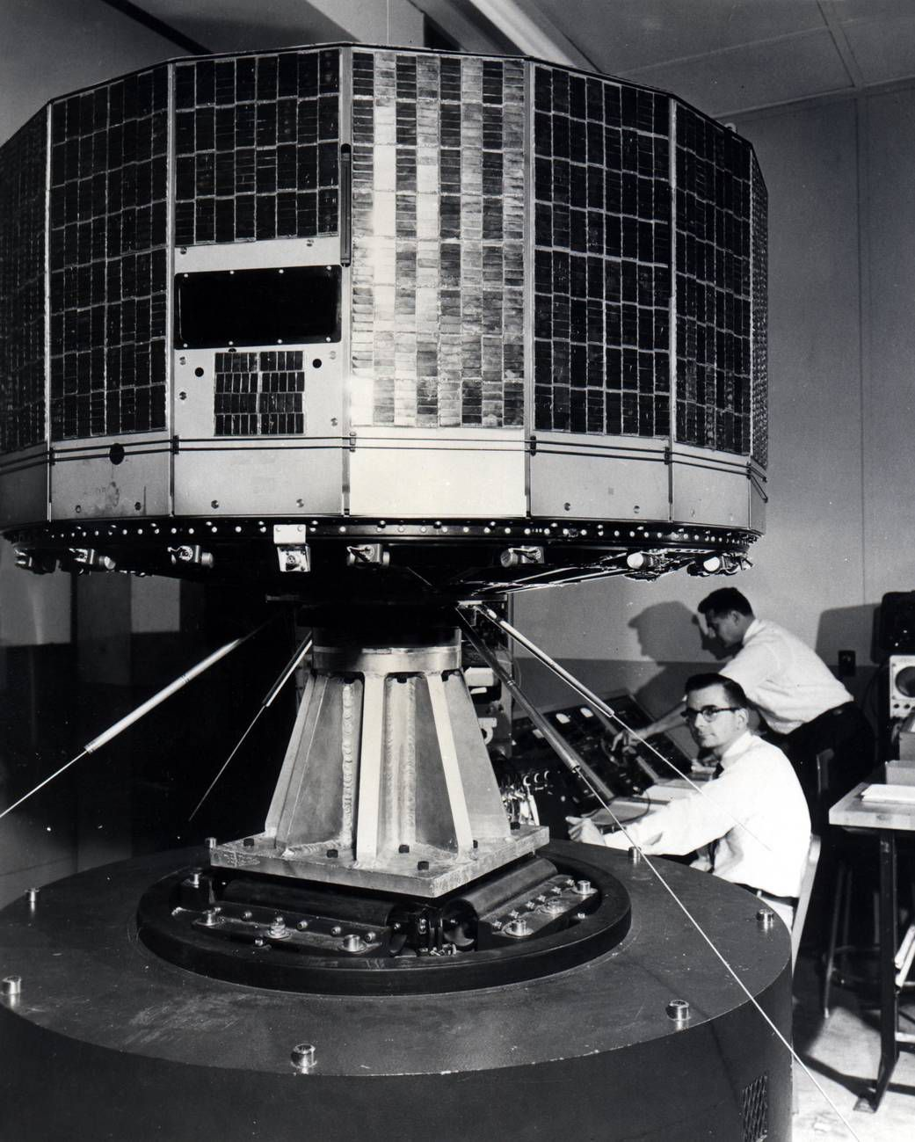
Weather Satellite History
TIROS
Television InfraRed Observational Satellite
POES - Polar Operational Environmental Satellite
Launches started in 1960 and last launch was in 2009 (NOAA-19)
Orbit is 850km
Live image streaming initially via APT, but now many more protocols like HRPT, CDA, DSB

Slide 7
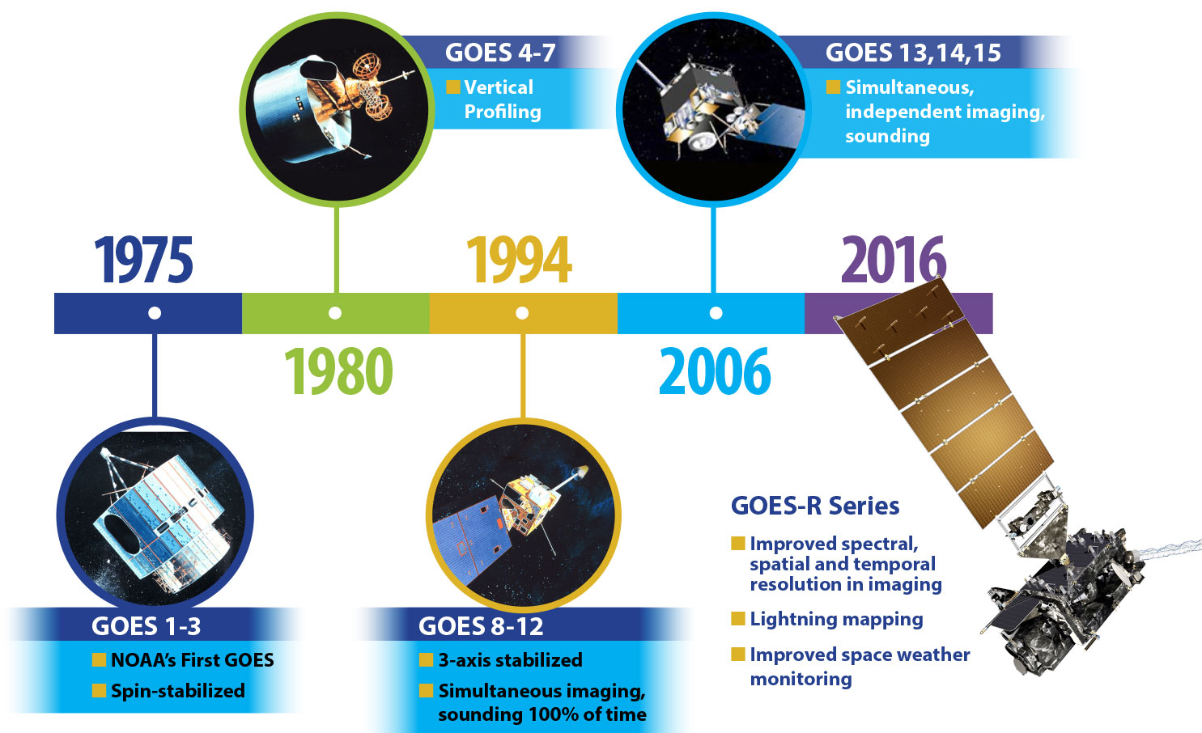
Weather Satellite History
GOES
Geostationary Operational Environmental Satellites
Launches started in 1975 and last launch was June 2024 (GOES-19)
Orbit is 35,790km
HRIT protocol at 400Kbps

Slide 8
Weather Satellite History
Russia: Meteor and RESURS
Europe: Metop-A, B and C
China: FY-3A, 3B and 3C
India also has some

Slide 9
RECEPTION

Slide 10
Data Available
NOAA-15, 16, 18 (POES)
Cloud coverage, thermals, ocean data
APT
Automatic Picture Transmission
137.5Mhz
HRPT
High Resolution Picture Transmission
1.7Ghz (L-band)

Slide 11
Data Available
NOAA GOES-16, 17
‘Full disc’ images, tropical storm graphics, others
HRIT/EMWIN
High Rate Information Transmission
Emergency Managers Weather Information
1694.1Mhz (L-band)

Slide 12
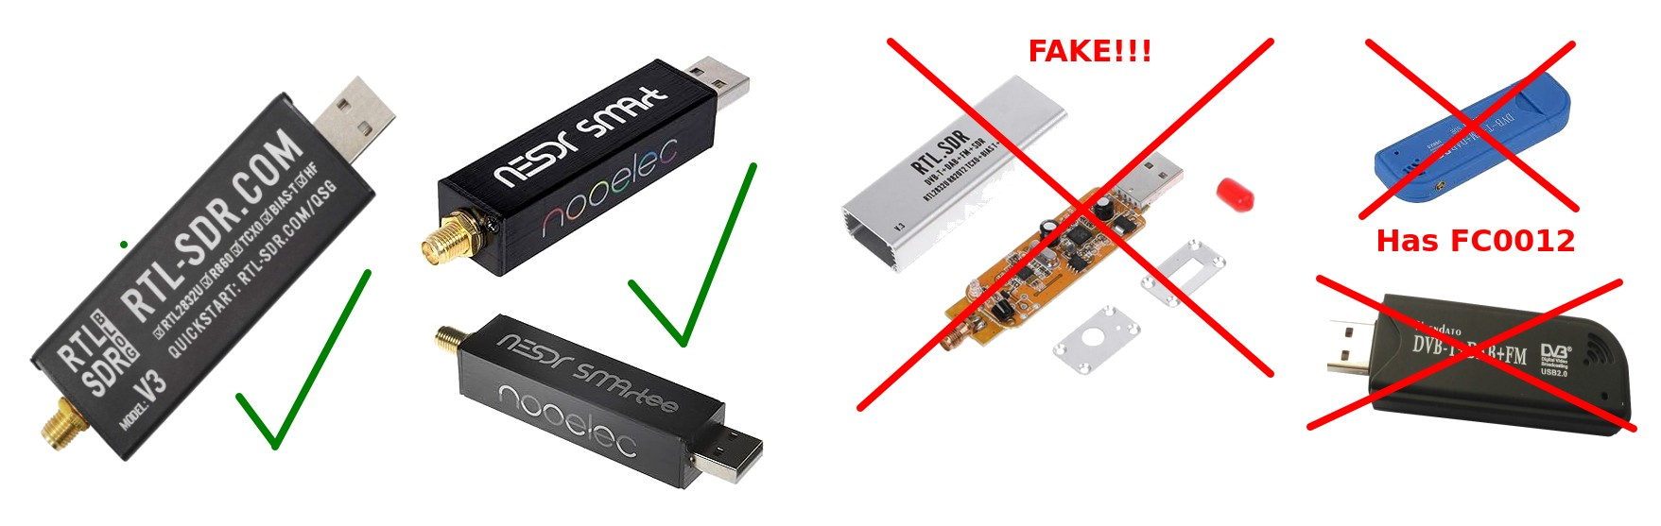
Radios
RTL-SDR
Currently about $35
Beware of fakes
Recommended
https://www.a-centauri.com/articoli/easy-hrpt-guide

Slide 13
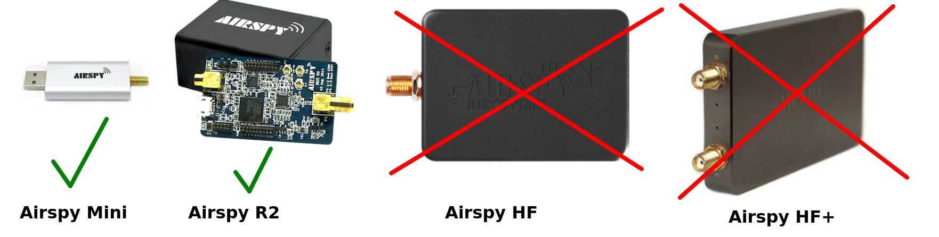
Radios
Airspy Mini/R2
Currently about $99
HF and HF+ can’t do L-band
https://www.a-centauri.com/articoli/easy-hrpt-guide

Slide 14
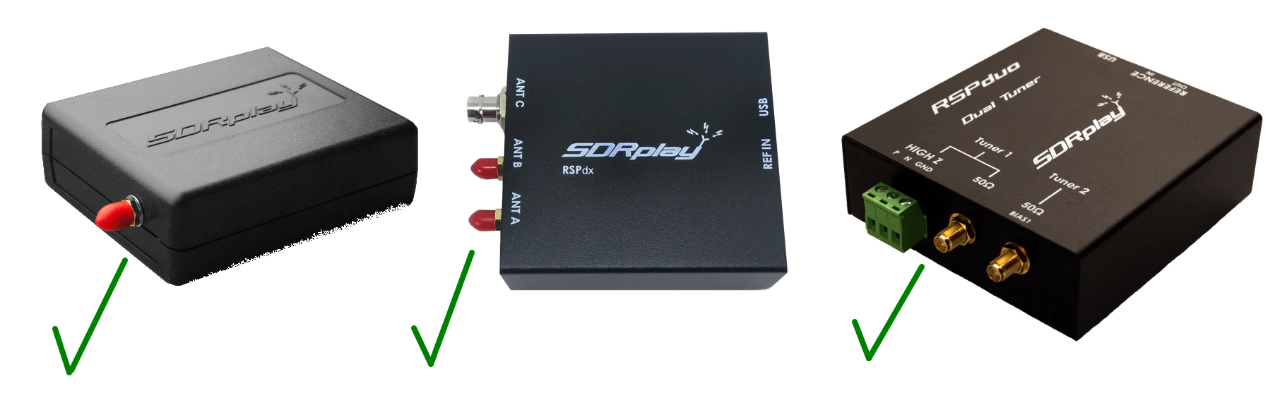
Radios
SDRPlay
Currently about $140-300
Beware that bias-T output is weak
https://www.a-centauri.com/articoli/easy-hrpt-guide

Slide 15
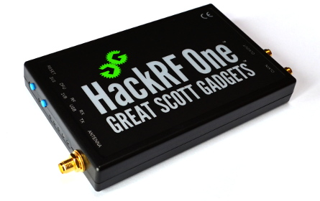
Radios
HackRF
Currently about $340
Very wide bandwidth
https://www.a-centauri.com/articoli/easy-hrpt-guide

Slide 16
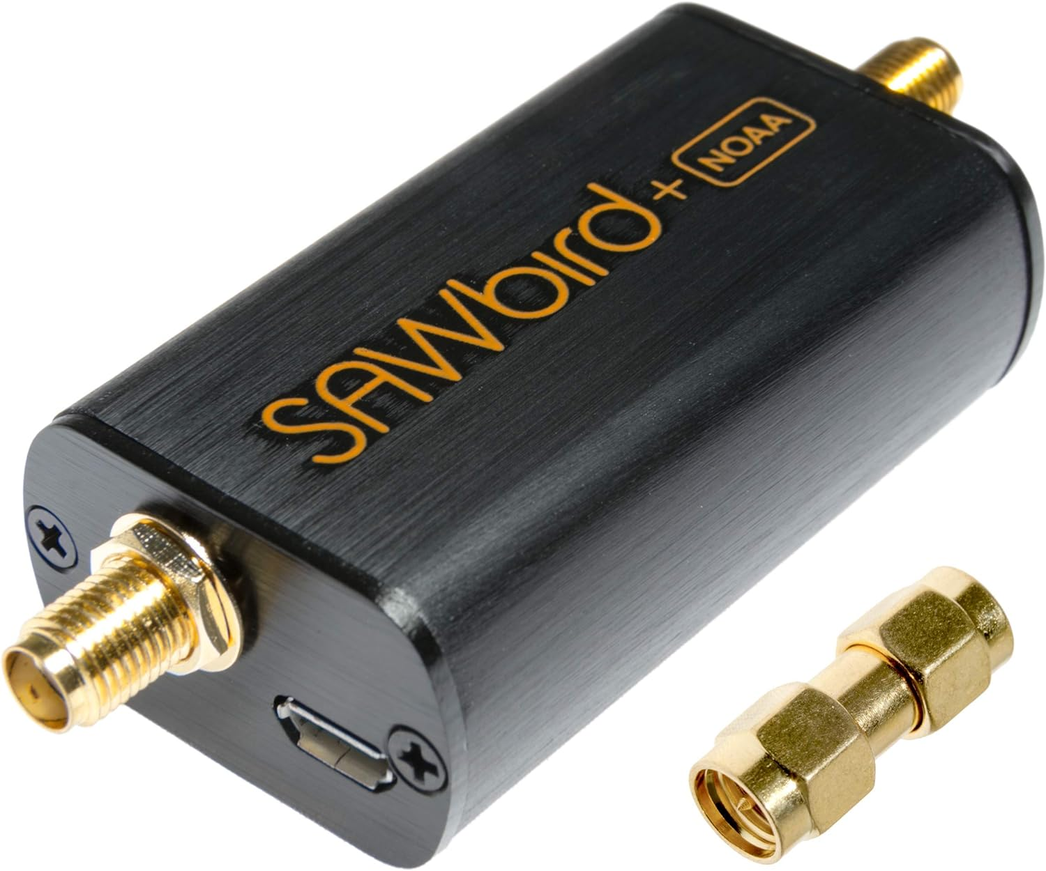
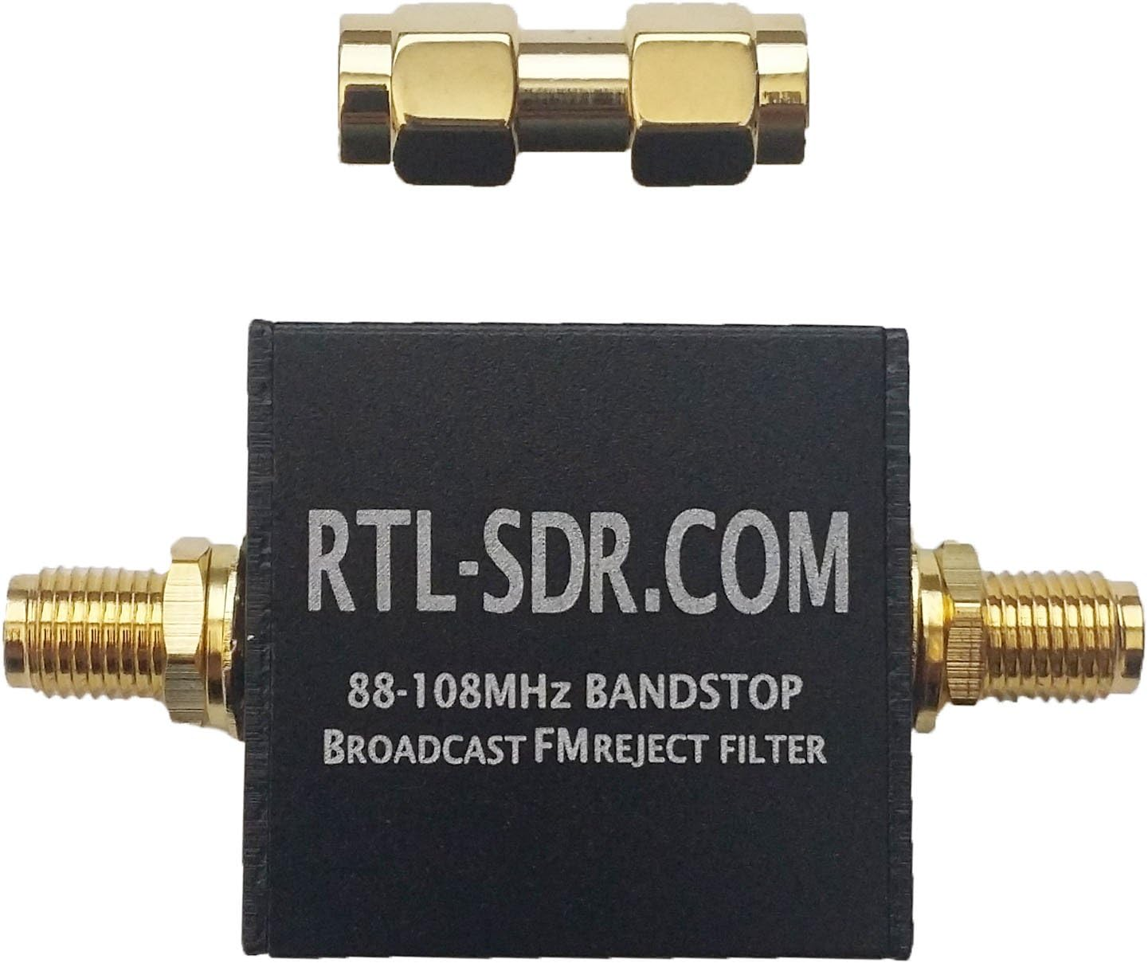
Filters / Amps
SAWbird Filter + Amp
Models for NOAA APT and GOES
Nice to have
FM block
Blocks FM transmissions
Don’t need both

Slide 17
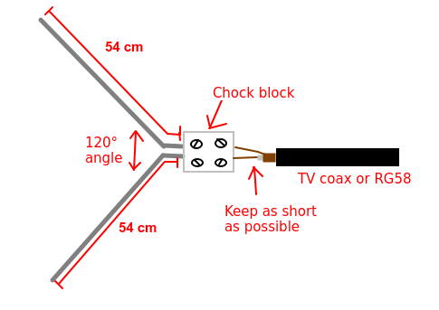
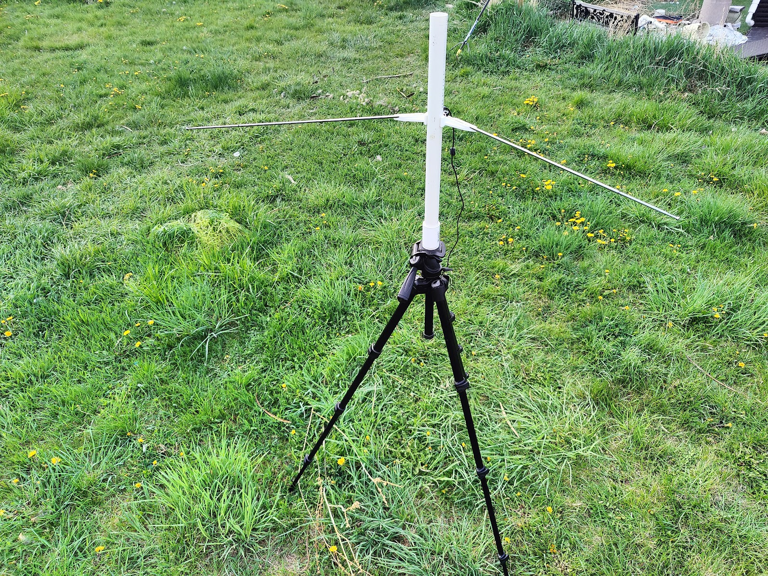
Antennas
137.5Mhz
V-Dipole
Cheap
Works well
Spacing to ground important
https://www.a-centauri.com/articoli/noaa-poes-satellites-reception

Slide 18
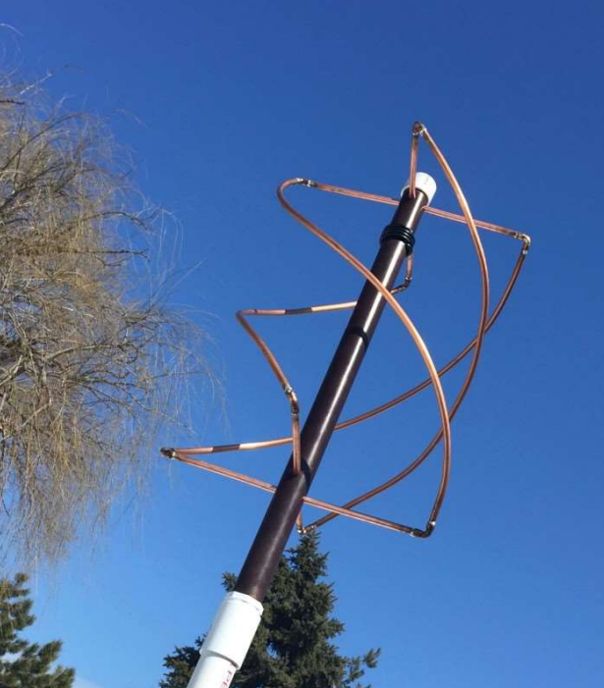
Antennas
137.5Mhz
QRH
Quadrifilar Helix Antenna
Set and forget
RHCP
Hard to build well
https://usradioguy.com/wp-content/uploads/2020/05/20200307-How-To-Build-A-QFH.pdf

Slide 19
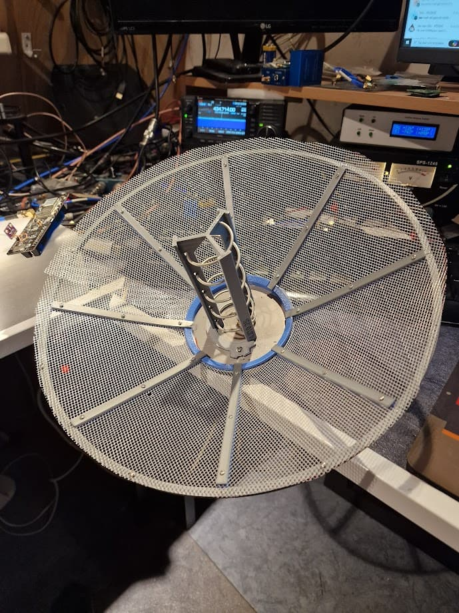
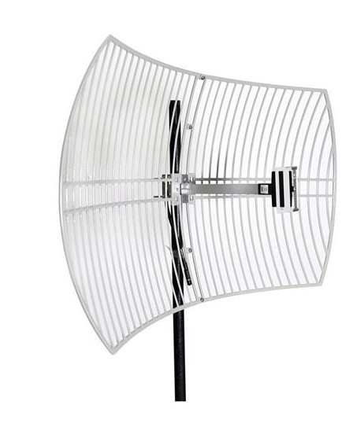
Antennas
L-band (1.6-1.7Ghz)
Need a dish reflector
Possible to reuse an old WiFi dish
Plans available to 3D print an antenna

Slide 20
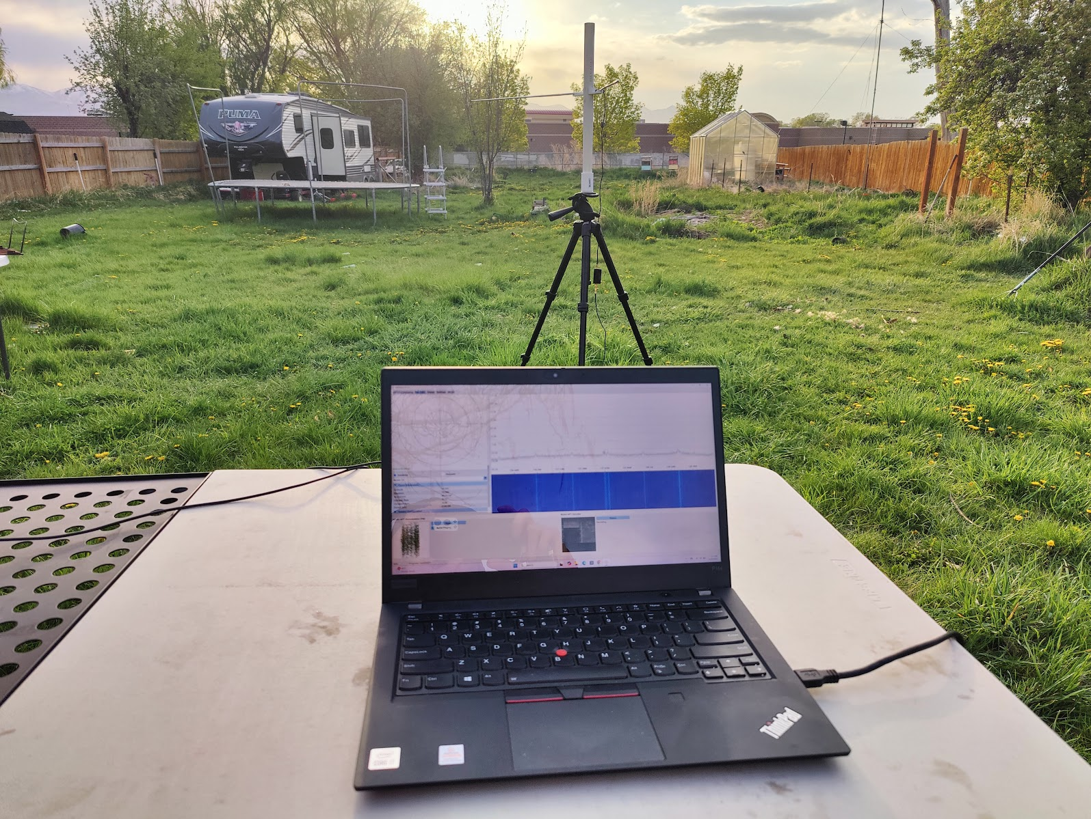
My Setup
RTL-SDR
SAWbird NOAA
The dipole antenna that came with the RTL-SDR
3D printed jig for antenna (in my github)
Laptop

Slide 21
DECODING

Slide 22
Software
Windows
MacOS
Linux
Android
SDR Software
SDR++
SDR#
Others
Satellite Decoding
SatDump
WXtoImg
Satellite Tracking
Gpredict
Look4Sat
Lots of others

Slide 23

Next Steps

Slide 24
Thanks!
Questions?
bsky - @hamster.dczia.net
GitHub - hamster

